Slide 1
Chapter 2:-
Conventional Encryption Techniques
Compiled By:- Akash Mehta
GIT.
Notes:
Akash Mehta

Slide 2
Outline
Simplified DES
Block Cipher Principles
The Data Encryption Standard (DES), The Strength of DES
Differential and Linear Cryptanalysis
Block Cipher Design Principles
Block Cipher Modes of Operation
Algorithms Like Triple DES, International Data Encryption Algorithm
Blowfish, Rc5, Cast-128, Rc2, Characteristics Of Advanced Symmetrical Block Cipher
Issues Of Conventional Encryption Like Traffic Distribution, Random Number Generation, Key Distribution
Akash Mehta

Slide 3
Modern Block Ciphers
will now look at modern block ciphers
one of the most widely used types of cryptographic algorithms
provide secrecy and/or authentication services
in particular will introduce DES (Data Encryption Standard) or DEA (Data Encryption Algorithm)
Akash Mehta

Slide 4
Block vs Stream Ciphers
block ciphers process messages in into blocks, each of which is then en/decrypted
like a substitution on very big characters
  64-bits or more
stream ciphers process messages a bit or byte at a time when en/decrypting
many current ciphers are block ciphers
hence are focus of course
Akash Mehta
Notes:
Block ciphers work a on block / word at a time, which is some number of bits. All of these bits have to be available before the block can be processed. Stream ciphers work on a bit or byte of the message at a time, hence process it as a “stream”.

Slide 5
Simplified DES (S-DES)
A product cipher
  two identical sub-ciphers
Each sub-cipher
  Permutation
  Substitution
Akash Mehta

Slide 6
S-DES
Encryption
  Input: 8-bit plaintext
  Input: 10-bit key K
  Output: 8-bit ciphertext
Decryption
  Input: 8-bit ciphertext
  Input: 10-bit key K
  Output: 8-bit plaintext
Akash Mehta

Slide 7
Simplified DES (cont.)
Key generation
  P10: a permutation of 10 bits
  shift: shift (rotate) the input
  P8: a permutation of 8-bit
Encryption/Decryption
  IP: initial permutation
  f_{K}: a complex function (substitution+permutation)
  SW: a simple permutation (swapping)
  f_{K}: a complex function (substitution+permutation) again
  IP⁻¹: the inverse of IP
Akash Mehta

Slide 8
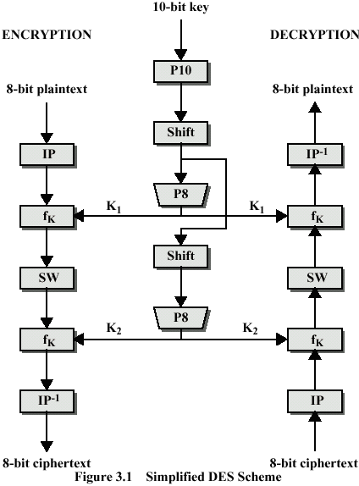
Akash Mehta

Slide 9
Initial Permutation (IP)‏
Move the bits of the original character around a little…
k1 k2 k3 k4 k5 k6 k7 k8
k2 k6 k3 k1 k4 k8 k5 k7
Akash Mehta

Slide 10
Encryption Detail
I P
4
E/P
8
K ₁
4
4
4
S0
S1
2
2
P4
4
SW
E/P
K ₂
S0
S1
P4
Akash Mehta
I P ⁻¹

Slide 11
Expansion/Permutation (E/P)‏
Expand 4 bits into 8 and permutate them…
k1 k2 k3 k4
k4 k1 k2 k3 k2 k3 k4 k1
Akash Mehta

Slide 12
Key Generation
10
P10
5
5
LS-1
LS-1
5
5
P8
8
K₁
LS-2
LS-2
5
5
P8
8
K₂
Akash Mehta

Slide 13
P10 Permutation
k1 k2 k3 k4 k5 k6 k7 k8 k9 k10
k3 k5 k2 k7 k4 k10 k1 k9 k8 k6
Akash Mehta

Slide 14
P8 Permutation
Permutate 10 into 8
k1 k2 k3 k4 k5 k6 k7 k8 k9 k10
k6 k3 k7 k4 k8 k5 k10 k9
Akash Mehta

Slide 15
LS-1
Left circular shift 1 each 5 bit group
k3 k 5 k 2 k7 k 4
k10 k1 k9 k8 k6
k5 k 2 k7 k4 k 3
k1 k9 k8 k6 k10
Akash Mehta

Slide 16
LS-2
Left circular shift 2 each 5 bit group
k3 k5 k2 k7 k4
k10 k1 k9 k8 k6
k2 k7 k4 k3 k5
k9 k8 k6 k10 k1
Akash Mehta

Slide 17
Overview of S-DES
Subkey generation
  K₁=P8 • shift • P10 (K)
  K₂=P8 • shift • shift • P10 (K)
Encryption
  C= IP⁻¹ • f_{K2} • SW • f_{K1} • IP (P)
Decryption
  P= IP⁻¹ • f_{K1} • SW • f_{K2} • IP (C)
Akash Mehta

Slide 18
Block Cipher Principles
most symmetric block ciphers are based on a Feistel Cipher Structure
needed since must be able to decrypt ciphertext to recover messages efficiently
block ciphers look like an extremely large substitution
would need table of 2⁶⁴ entries for a 64-bit block
instead create from smaller building blocks
using idea of a product cipher
Akash Mehta
Notes:
An arbitrary reversible substitution cipher for a large block size is not practical, however, from an implementation and performance point of view. In general, for an n-bit general substitution block cipher, the size of the key is n x 2^{n}. For a 64-bit block, which is a desirable length to thwart statistical attacks, the key size is 64 x 2⁶⁴ = 2⁷⁰ = 10²¹ bits.

Slide 19
Claude Shannon and Substitution-Permutation Ciphers
in 1949 Claude Shannon introduced idea of substitution-permutation (S-P) networks
  modern substitution-transposition product cipher
these form the basis of modern block ciphers
S-P networks are based on the two primitive cryptographic operations we have seen before:
  substitution (S-box)
  permutation (P-box)
provide confusion and diffusion of message
Akash Mehta
Notes:
Claude Shannon’s 1949 paper has the key ideas that led to the development of modern block ciphers. Critically, it was the technique of layering groups of S-boxes separated by a larger P-box to form the S-P network, a complex form of a product cipher. He also introduced the ideas of confusion and diffusion, notionally provided by S-boxes and P-boxes (in conjunction with S-boxes).

Slide 20
Product Ciphers
Shannon introduced the concept of a product cipher. A product cipher is a complex cipher combining substitution, permutation, and other components discussed in previous sections.
Akash Mehta

Slide 21

Contd…
Diffusion
The idea of diffusion is to hide the relationship between the ciphertext and the plaintext.
Note
Diffusion hides the relationship between the ciphertext and the plaintext.
Akash Mehta

Slide 22
Contd…
Confusion
The idea of confusion is to hide the relationship between the ciphertext and the key.
Note
Confusion hides the relationship between the ciphertext and the key.
Akash Mehta

Slide 23
Confusion and Diffusion
Shannon suggests the “statistical analysis”
Confusion
  Blur the relation between the ciphertext and the encryption key
  Substitution
Diffusion
  Each ciphertext alphabet is affected by many plaintext alphabet
  Repeated permutations
Akash Mehta

Slide 24
Feistel Cipher Structure
Horst Feistel devised the feistel cipher
  based on concept of invertible product cipher
partitions input block into two halves
  process through multiple rounds which
  perform a substitution on left data half
  based on round function of right half & subkey
  then have permutation swapping halves
implements Shannon’s substitution-permutation network concept
Akash Mehta
Notes:
Horst Feistel, working at IBM Thomas J Watson Research Labs devised a suitable invertible cipher structure in early 70's.
One of Feistel's main contributions was the invention of a suitable structure which adapted Shannon's S-P network in an easily inverted structure. Essentially the same h/w or s/w is used for both encryption and decryption, with just a slight change in how the keys are used. One layer of S-boxes and the following P-box are used to form the round function.

Slide 25
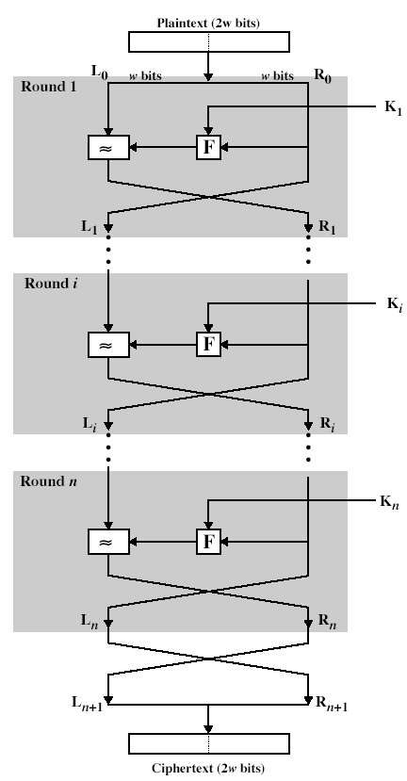
Feistel Cipher Structure
Akash Mehta

Slide 26
Feistel Cipher Design Principles
Block size
  increasing size improves security, but slows cipher
Key size
  increasing size improves security, makes exhaustive key searching harder, but may slow cipher
Number of rounds
  increasing number improves security, but slows cipher
Subkey generation
  greater complexity can make analysis harder, but slows cipher
Round function
  greater complexity can make analysis harder, but slows cipher
Akash Mehta

Slide 27
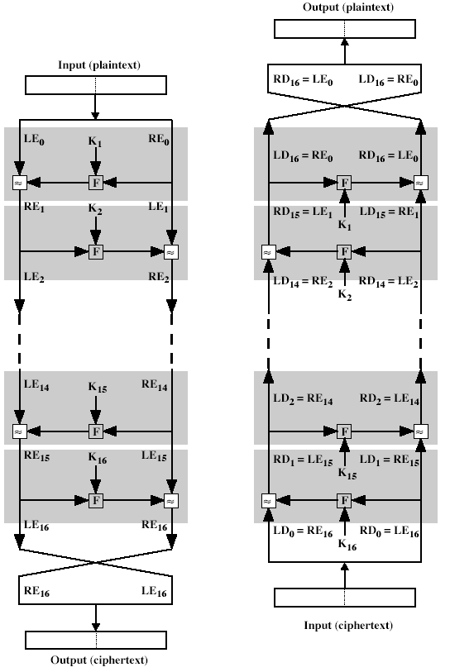
Feistel Cipher En/Decryption
Akash Mehta
Notes:
The process of decryption with a Feistel cipher is essentially the same as the encryption process. The rule is as follows: Use the ciphertext as input to the algorithm, but use the subkeys Ki in reverse order. That is, use Kn in the first round, Kn–1 in the second round, and so on until K1 is used in the last round. This is a nice feature because it means we need not implement two different algorithms, one for encryption and one for decryption.

Slide 28
Average time required for exhaustive key search
Key Size (bits) | Number of Alternative Keys | Time required at 10⁶ Decryption/µs
32 | 2³² = 4.3 x 10⁹ | 2.15 milliseconds
56 | 2⁵⁶ = 7.2 x 10¹⁶ | 10 hours
128 | 2¹²⁸ = 3.4 x 10³⁸ | 5.4 x 10¹⁸ years
168 | 2¹⁶⁸ = 3.7 x 10⁵⁰ | 5.9 x 10³⁰ years
Akash Mehta

Slide 29
Data Encryption Standard (DES)
most widely used block cipher in world
encrypts 64-bit data using 56-bit key
has widespread use
has been considerable controversy over its security
Akash Mehta

Slide 30
DES History
IBM developed Lucifer cipher
  by team led by Feistel
  used 64-bit data blocks
then redeveloped as a commercial cipher with input from NSA and others
in 1973 NBS issued request for proposals for a national cipher standard
IBM submitted their revised Lucifer which was eventually accepted as the DES
Akash Mehta

Slide 31
Security analysis of DES
Why 56 bits?
  Lucifer’s key is 128-bit long
  Rumor: it was deliberately reduced so that NSA can break it
  Facts
    1997: distributed exhaustive key search all over the world takes 3 months.
    1998: specialized key search chips take 56 hours
    1999: the search device is improved and achieves the record of 22 hours
Akash Mehta

Slide 32
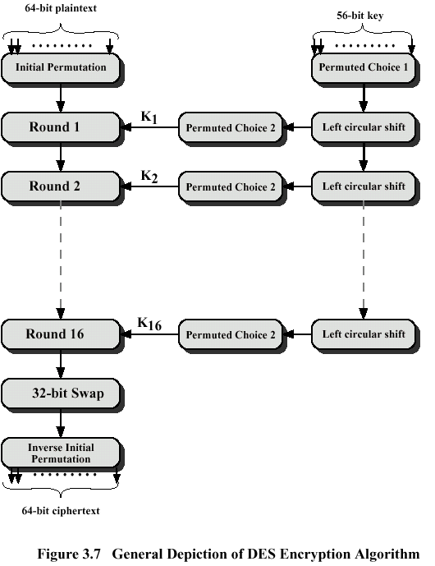
Akash Mehta

Slide 33
DES
Step 1
Plain Text (64 bits)
Initial Permutation (IP)
Step 2
LPT
RPT
Step 3
KEY
16 rounds
16 rounds
KEY
Step 4
Final Permutation (FP)
Step 5
Step 6
Cipher Text (64 bits)
Akash Mehta

Slide 34

Continued
Figure
Key generation
Akash Mehta

Slide 35
Details of one Round in DES
Key Transformation
Expansion Permutation
S-Box Substitution
P-Box Permutation
XOR and Swap
Akash Mehta

Slide 36
Avalanche effect
A small change in either the plaintext or the key should produce a significant change in the ciphertext
In particular, one bit change in either the plaintext or the key ➔ half bits change in ciphertext
Akash Mehta

Slide 37
Avalanche effect (cont.)
For example
  P1=0000 0000 ⋅⋅⋅ 0000
  P2=1000 0000 ⋅⋅⋅ 0000
  K=0000001 1001011 0100100 1100010 0011100 0011000 0011100 0110010
  Then, 34 bits differ in C=R₁₆L₁₆
    Avalanche effect
Akash Mehta

Slide 38
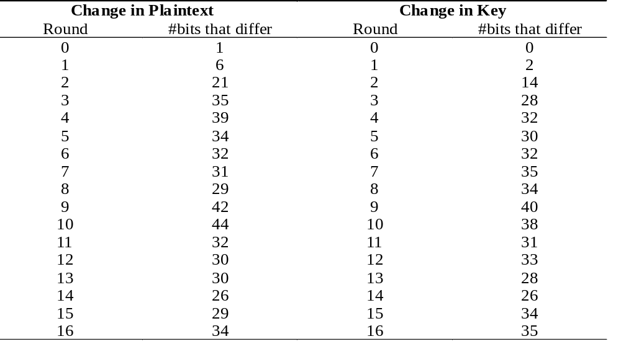
Fast avalanche effect
The avalanche effect within the first few rounds; for example, the first 3 rounds.
Akash Mehta

Slide 39
Modes of Operation
block ciphers encrypt fixed size blocks
eg. DES encrypts 64-bit blocks, with 56-bit key
need way to use in practise, given usually have arbitrary amount of information to encrypt
four were defined for DES in ANSI standard ANSI X3.106-1983 Modes of Use
subsequently now have 5 for DES
Akash Mehta
Notes:
DES (or any block cipher) forms a basic building block, which en/decrypts a fixed sized block of data. However to use these in practise, we usually need to handle arbitrary amounts of data, which may be available in advance (in which case a block mode is appropriate), and may only be available a bit/byte at a time (in which case a stream mode is used).

Slide 40
Modes of operations (Overview)
Advantages and disadvantages: goals
  Same plaintext blocks => Same Cipher blocks
  Padding
  Stream cipher => Error propagation
  Parallel encryption/decryption
Padding message (64bits block)
  Electronic codebook mode (ECB)
  Cipher block chaining mode (CBC)
Convert DES to Stream cipher (1 bit or 8 bits)
  Cipher feedback mode (CFB)
  Output feedback mode (OFB)
Parallel encryptions
  Counter (CTR)
Akash Mehta

Slide 41
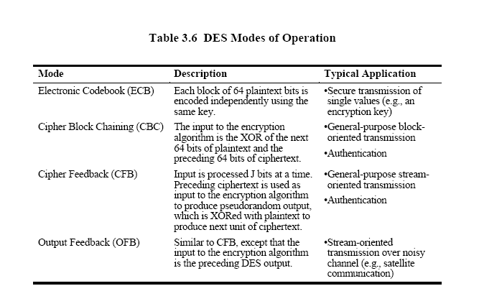
Akash Mehta

Slide 42
ECB mode
Simplest mode
Each block of 64-bit plaintext is handled independently
It is like a codebook (huge) lookup
The same 64-bit block has the same cipher text
Same key is used in all block encryption.
APPLICATION :-
Secured Transmission of Key.
Akash Mehta

Slide 43
ECB mode (cont.)
Encryption
  Key: K
  Plaintext: P=P₁P₂…P_{N-1}P_{N}
  Ciphertext: C=C₁C₂…C_{N}
    C_{i} = E_{K}(P_{i}), 1≤i≤N
Akash Mehta

Slide 44
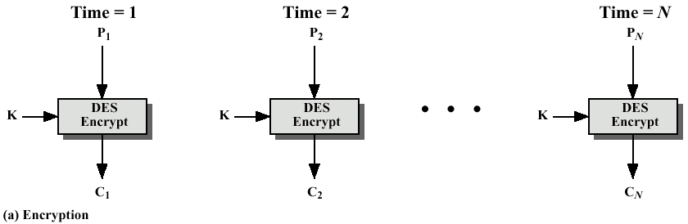
ECB mode (cont.)
Akash Mehta

Slide 45
ECB mode (cont.)
Decryption
  Key: K
  Ciphertext: C=C₁C₂…C_{N}
  Plaintext: P₁P₂…P_{N-1}P_{N}
    P_{i} = D_{K}(C_{i}), 1≤i≤N
Akash Mehta

Slide 46
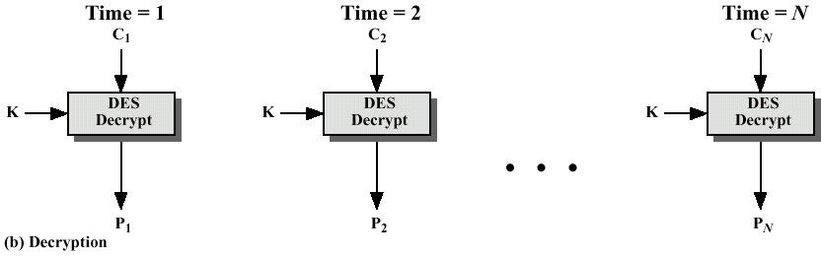
ECB mode (cont.)
Akash Mehta

Slide 47
Advantages and Limitations of ECB
repetitions in message generate the same ciphertext
  particularly with data such graphics
main use is sending a few blocks of data
Akash Mehta
Notes:
ECB is not appropriate for any quantity of data, since repetitions can be seen, esp. with graphics, and because the blocks can be shuffled/inserted without affecting the en/decryption of each block.

Slide 48
Cipher Block Chaining (CBC)
message is broken into blocks
but these are linked together in the encryption operation
each previous cipher blocks is chained with current plaintext block, hence name
use Initial Vector (IV) to start process
  C_{i} = DES_{K1}(P_{i} XOR C_{i-1})
  C₋₁ = IV
APPLICATION :-
bulk data encryption, authentication
Akash Mehta
Notes:
To overcome the problems of repetitions and order independence in ECB, want some way of making the ciphertext dependent on all blocks before it. This is what CBC gives us, by combining the previous ciphertext block with the current message block before encrypting. To start the process, use an Initial Value (IV), which is usually well known (often all 0's), or otherwise is sent, ECB encrypted, just before starting CBC use. CBC mode is applicable whenever large amounts of data need to be sent securely, provided that its available in advance (eg email, FTP, web etc)

Slide 49
CBC mode (Cont….)
Goal: the same plaintext block is encrypted into different ciphertext block
Initial vector (IV)
  64-bit long
  Fixed
Padded plaintext: P’= P₁P₂…P_{N}
Ciphertext: C = C₁C₂…C_{N}
  C₁=E_{K}(IV ⊕ P₁)
  C_{i}=E_{K}(C_{i-1} ⊕ P_{i}), 2≤i≤N
Akash Mehta

Slide 50
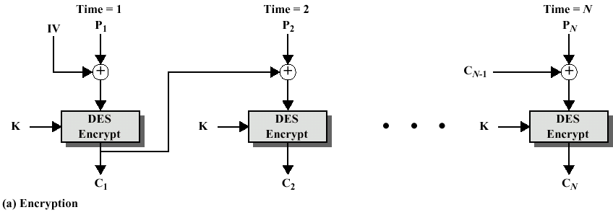
CBC mode (cont.)
Akash Mehta

Slide 51
CBC mode (cont.)
Decryption
  Key: K
  Ciphertext: C=C₁C₂…C_{N}
  Padded plaintext: P=P₁P₂…P_{N}
    P₁=D_{K}(C₁) ⊕ IV
    P_{i}= D_{K}(C_{i}) ⊕ C_{i-1}= C_{i-1}⊕P_{i}⊕C_{i-1}
Akash Mehta

Slide 52
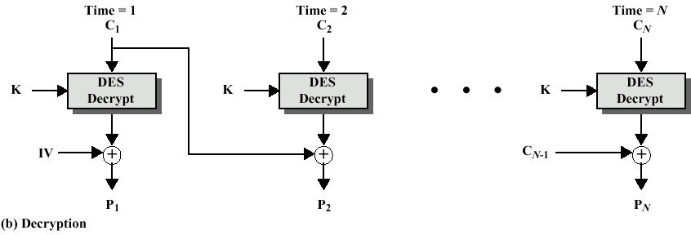
CBC mode (cont.)
Akash Mehta

Slide 53
Advantages and Limitations of CBC
each ciphertext block depends on all message blocks
thus a change in the message affects all ciphertext blocks after the change as well as the original block
need Initial Value (IV) known to sender & receiver
  however if IV is sent in the clear, an attacker can change bits of the first block, and change IV to compensate
  hence either IV must be a fixed value or it must be sent encrypted in ECB mode before rest of message
Akash Mehta
Notes:
CBC is the generally used block mode. The chaining provides an avalanche effect, which means the encrypted message
cannot be changed or rearranged without totally destroying the subsequent data.
One issue is how to handle the last block, which may well not be complete. In general have to pad this block (typically with 0's), and then must recognise padding at other end - may be obvious (eg in text the 0 value should usually not occur), or otherwise must explicitly have the last byte as a count of how much padding was used (including the count). Note that if this is done, if the last block IS an even multiple of 8 bytes, will have to add an extra block, all padding so as to have a count in the last byte.

Slide 54
CFB mode (Cipher feedback)
Stream cipher mode
One-time pad
Block size: J bits, 1≤J≤ 64
Need no padding in most cases
  For example, we set J=8
Akash Mehta

Slide 55
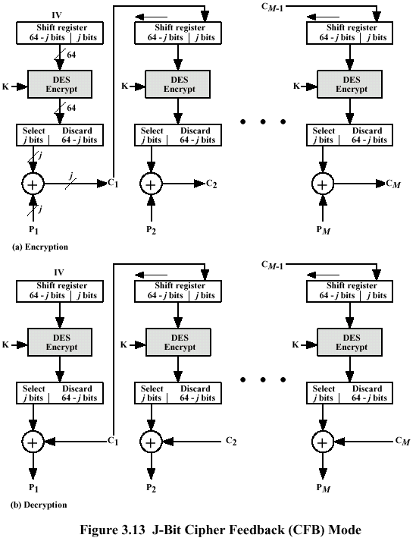
Akash Mehta
Notes:
The size of ciphertext is same as plain text i.e j bits

Slide 56
CFB mode (cont.)
Encryption: J-bit CFB
  Plaintext: P = P₁P₂⋅⋅⋅P_{N}, P_{i}’s are J-bit blocks
  S_{J}(X): the leftmost J bits of X
  T_{64-J}(Y): the rightmost 64-J bits of Y
  Algorithm
    R=IV
    For i=1 to N
      C_{i}= P_{i} ⊕ S_{J}(E_{K}(R))
      R=T_{64-J}(R)||C_{i-1}
Akash Mehta

Slide 57
CFB mode (cont.)
Decryption: J-bit CFB
  Ciphertext: C= C₁C₂⋅⋅⋅C_{N}, C_{i}’s are J-bit blocks
  S_{J}(X): the leftmost J bits of X
  T_{64-J}(Y): the rightmost 64-J bits of Y
  Algorithm
    R=IV
    For i=1 to N
      P_{i}= C_{i} ⊕ S_{J}(E_{K}(R))
      R=T_{64-J}(R)||C_{i-1}
Akash Mehta

Slide 58
Advantages and Limitations of CFB
appropriate when data arrives in bits/bytes
most common stream mode
Akash Mehta
Notes:
CFB is the usual stream mode. As long as can keep up with the input, doing encryptions every 8 bytes. A possible problem is that if its used over a "noisy" link, then any corrupted bit will destroy values in the current and next blocks (since the current block feeds as input to create the random bits for the next). So either must use over a reliable network transport layer (pretty usual) or use OFB.

Slide 59
OFB mode (Output feedback)
Similar to CFB, but output (not ciphertext) is fed back
uses: stream encryption over noisy channels
Akash Mehta

Slide 60
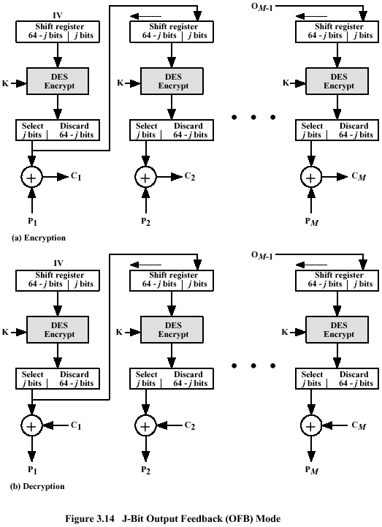
Akash Mehta

Slide 61
Counter (CTR)
similar to OFB but encrypts counter value rather than any feedback value
must have a different key & counter value for every plaintext block (never reused)
  C_{i} = P_{i} XOR O_{i}
  O_{i} = DES_{K1}(i)
uses: high-speed network encryptions(ATM & IPsecurity)
Akash Mehta

Slide 62
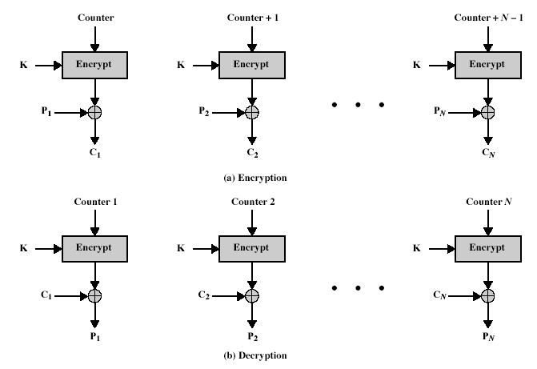
Counter (CTR)
Akash Mehta
Notes:
Stallings Fig 3.15

Slide 63
Advantages and Limitations of CTR
efficiency
  can do parallel encryptions
  in advance of need
  good for bursty high speed links
random access to encrypted data blocks
provable security (good as other modes) ?
but must ensure never reuse counter values, otherwise could break.
Akash Mehta

Slide 64
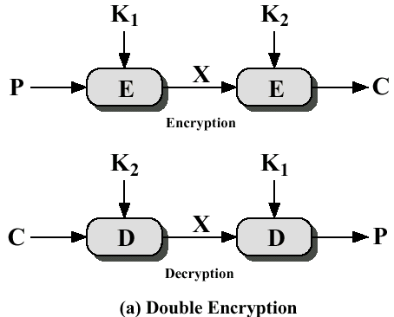
Double DES
Key size K=(K₁, K₂): 112 bits
C=E_{K2}(E_{K1}(P))
Akash Mehta

Slide 65
Double DES
Meet-in-the-Middle Attack
However, using a known-plaintext attack called meet-in-the-middle attack proves that double DES improves this vulnerability slightly (to 2⁵⁷ tests), but not tremendously (to 2¹¹²).
Akash Mehta

Slide 66
Double DES (cont.)
Meet-in-the-middle attack
  Given a pair (P, C)
  Let K_{i} be the ith key of the key space, 0 ≤ i ≤2⁵⁶-1
  Compute M_{i}=E_{Ki}(P), 0 ≤ i ≤2⁵⁶-1
  Compute N_{j}=D_{Kj}(C), 0 ≤ i ≤2⁵⁶-1
  Check whether Mi=Nj
    If so, K=(Ki, Kj) is very likely to be the secret key
  Time: 2⁵⁶+2⁵⁶=2⁵⁷
Akash Mehta

Slide 67
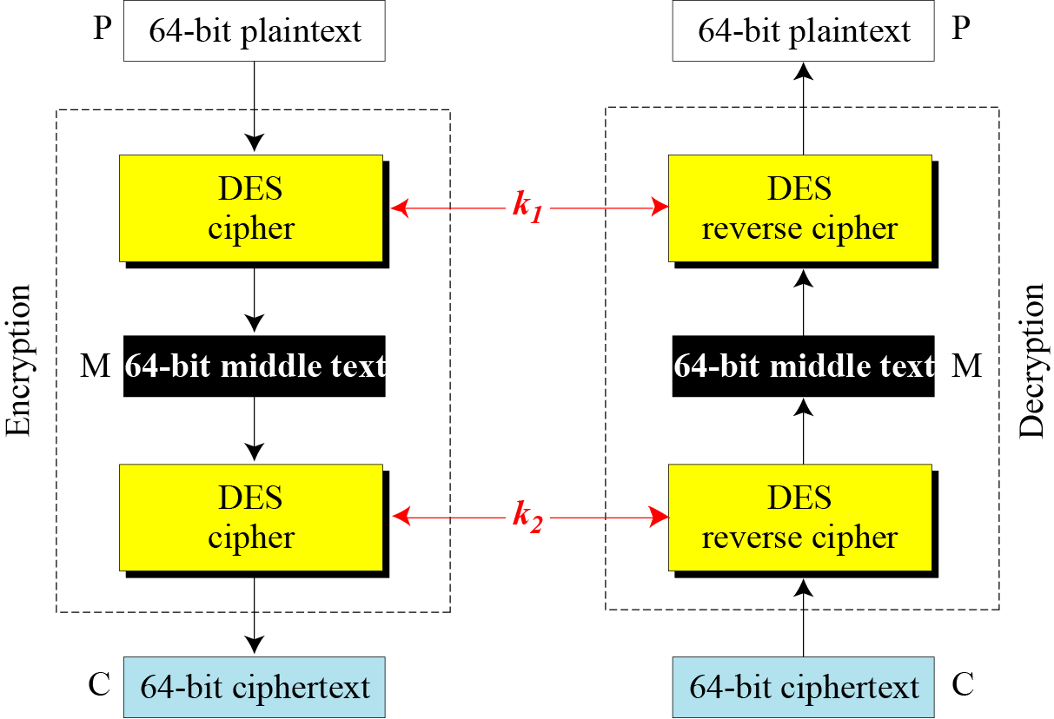
Continued
Meet-in-the-middle attack for double DES
Akash Mehta

Slide 68
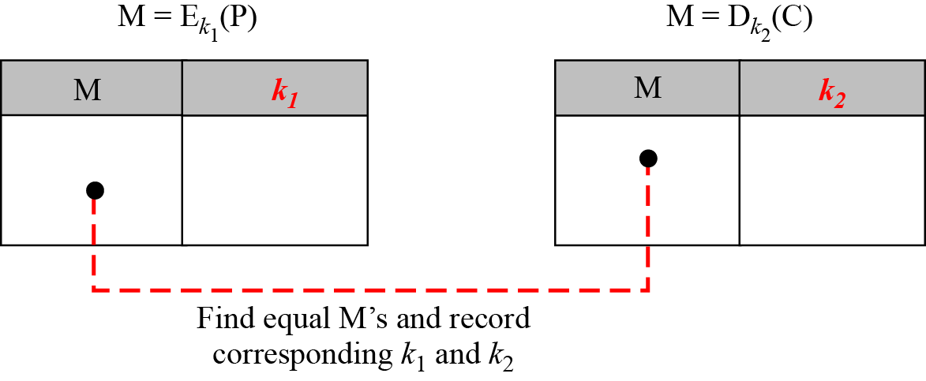
Continued
Tables for meet-in-the-middle attack
Akash Mehta

Slide 69
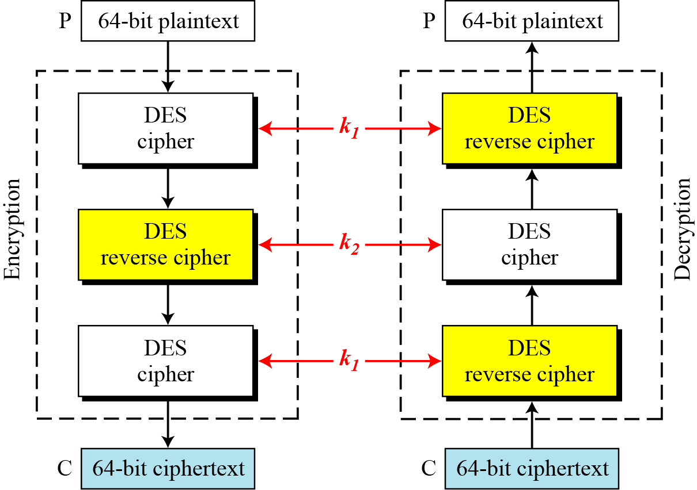
Triple DES
Triple DES with two keys
Akash Mehta

Slide 70
Triple DES
Plaintext, ciphertext: 64 bits
Key K=(K₁, K₂): 112 bits
Encryption: C=E_{K1}(D_{K2}(E_{K1}(P)))
Decryption: P=D_{K1}(E_{K2}(D_{K1}(P)))
Advantages
  Key size is larger
  Compatible with regular one-key DES
    Set K₁=K₂=K (56-bit)
    C=E_{K}(D_{K}(E_{K}(P)))=E_{K}(P)
    P=D_{K}(E_{K}(D_{K}(P)))=D_{K}(P)
Akash Mehta

Slide 71
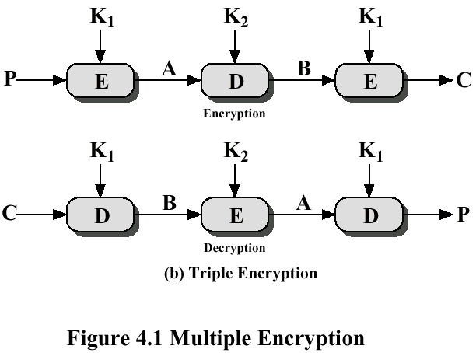
Continued
Akash Mehta

Slide 72
Continued
Triple DES with Three Keys
The possibility of known-plaintext attacks on triple DES with two keys has enticed some applications to use triple DES with three keys. Triple DES with three keys is used by many applications such as PGP .
Akash Mehta

Slide 73
IDEA…
(International Data Encryption Algorithm)
Plain text = 64 bit.
Key =128 bit.
Sub key = 52. (16 bit each)
Cipher text = 64.
Number of identical rounds =8.(6 key in each round)
And one output transformation round(4 key)
Akash Mehta

Slide 74
Design Issues
The design philosophy behind the algorithm is one of “ mixing operation from different algebraic groups”.
1) XOR
2)Addition modulo 2¹⁶
3) Multiplication modulo 2¹⁶ + 1
Akash Mehta

Slide 75
IDEA
P.T (64 bits)
P1(16bits)
P2(16bits)
P3(16bits)
P4(16bits)
Round 1
K1
K6
Round 2
K7
K12
. . .
Round 8
K43
K48
Output Transformation
K49
K52
C1(16bits)
C2(16bits)
C3(16bits)
C4(16bits)
Akash Mehta
C.T (64 bits)

Slide 76
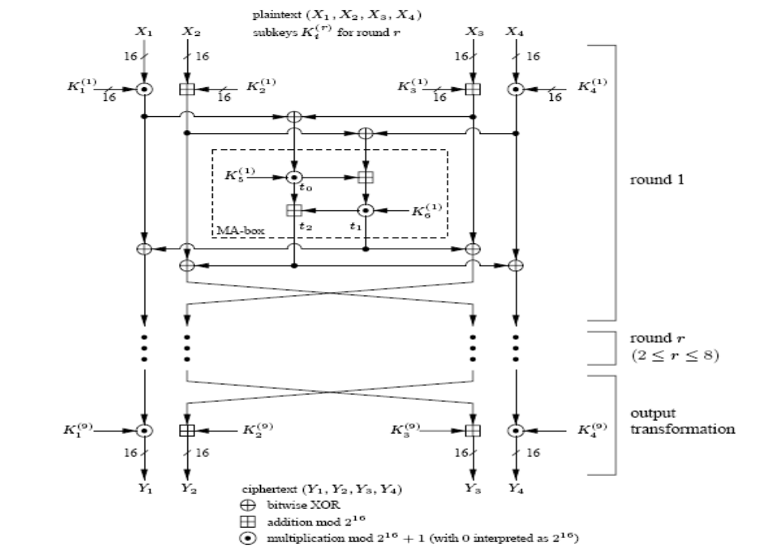
Akash Mehta

Slide 77
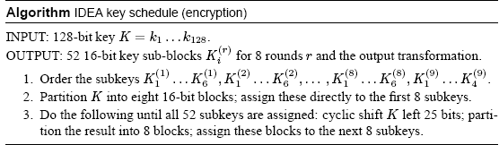
Encryption Key Generation.
Akash Mehta

Slide 78
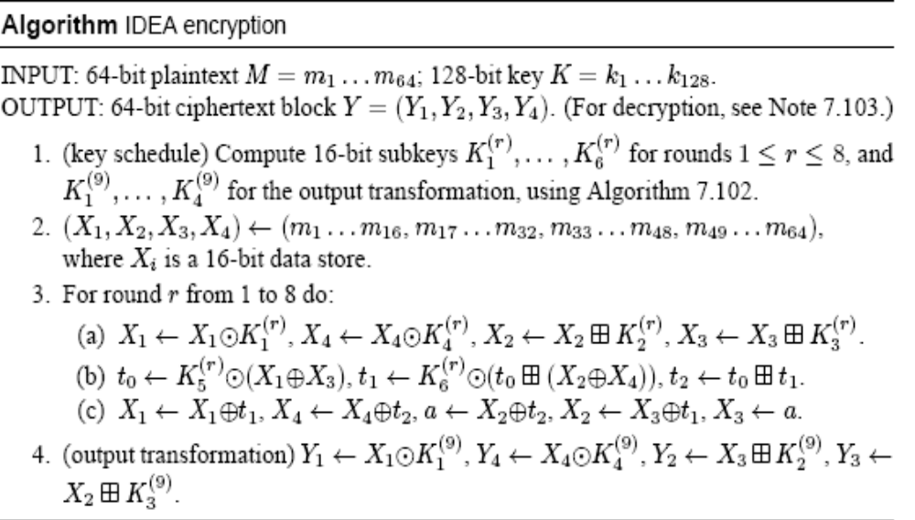
Encryption Algorithm.
Akash Mehta

Slide 79
Sequence of operation in One Round
1)Multiply P1 and K1
2)Add P2 and second K2
3)Add P3 and third K3
4)Multiply P4 and K4
5) Step 1 ⊕ step 3
6) Step 2 ⊕ step 4
7)Multiply step 5 with K5
8)Add result of step 6 and step 7
9) Multiply result of step 8 with K6.
Akash Mehta

Slide 80
Continue..
10)Add result of step 7 and step 9.
11) XOR result of steps 1 and step 9.
12) XOR result of steps 3 and step 9.
13) XOR result of steps 2 and step 10.
14) XOR result of steps 4 and step 10.
Akash Mehta

Slide 81
Operation in output transformation
1)Multiply P1 with K1.
2)Add P2 and K2.
3)Add P3 and K3.
4)Multiply P4 and K4.
Akash Mehta

Slide 82
Stream Ciphers
process the message bit by bit (or byes) (as a stream)
typically have a (pseudo) random stream key
combined (XOR) with plaintext bit by bit
randomness of stream key completely destroys any statistically properties in the message
  C_{i} = M_{i} XOR StreamKey_{i}
what could be simpler!!!!
but must never reuse stream key
  otherwise can remove effect and recover messages
Akash Mehta

Slide 83
Stream Cipher Properties
some design considerations are:
  long period with no repetitions
  statistically random
  depends on large enough key
  confusion
  diffusion
Akash Mehta
Notes:
Criteria from Rueppel

Slide 84
Stream Cipher: RC4(Rivest Cipher4)
RC4 was designed by Ron Rivest
variable key size, byte-oriented stream cipher
widely used (web SSL/TLS, WLAN WEP-not secure(Wireless Equivalent Privacy))
key forms random permutation of all 8-bit values
uses that permutation to scramble input info processed a byte at a time
Akash Mehta

Slide 85
RC5
a proprietary cipher owned by RSADSI
designed by Ronald Rivest (of RSA fame)
used in various RSADSI products
can vary key size / data size / no rounds
very clean and simple design
yet still regarded as secure
Akash Mehta

Slide 86
RC5 Ciphers
RC5 is a family of ciphers RC5-w/r/b
  w = word size in bits (16/32/64) nb data=2w
  r = number of rounds (0..255)
  b = number of bytes in key (0..255)
nominal version is RC5-32/12/16
  ie 32-bit words so encrypts 64-bit data blocks
  using 12 rounds
  with 16 bytes (128-bit) secret key
Akash Mehta

Slide 87
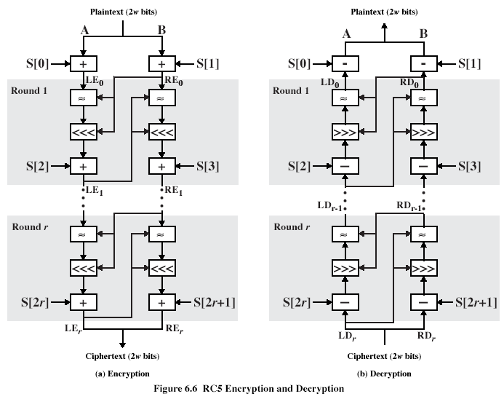
Akash Mehta

Slide 88
RC5 Encryption
split input into two halves A & B
  L₀ = A + S[0];
  R₀ = B + S[1];
  for i = 1 to r do
    L_{i} = ((L_{i-1} XOR R_{i-1}) <<< R_{i-1}) + S[2 x i];
    R_{i} = ((R_{i-1} XOR L_{i}) <<< L_{i}) + S[2 x i + 1];
need reasonable number of rounds (eg 12-16)
Akash Mehta

Slide 89
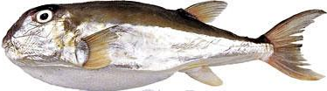
Blowfish
Blowfish
Designed by Bruce Schneier, 1993
Freely available (Unpatented; Royalty-free; No license required; Free source code available)
Block cipher: 64-bit block
Variable key length; 32 bits to 448 bits
Fast encryption (much faster than DES and IDEA)
Compact
Simple
Akash Mehta

Slide 90
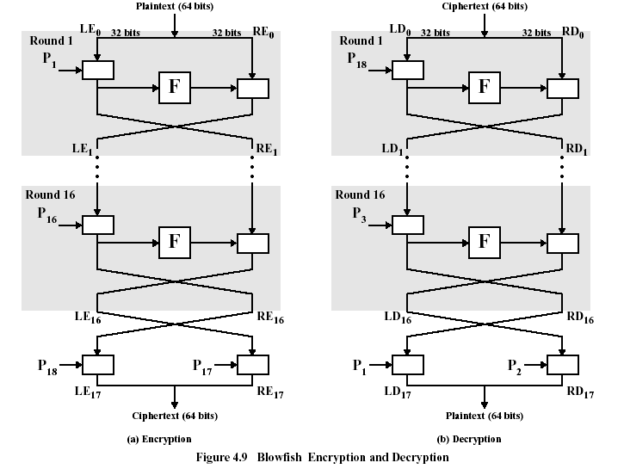
Blowfish Encryption/Decryption
Blowfish
Slight variant of classic Feistel network
  L and R are both processed in each round
  16 rounds
  Two extra XORs at the end
⊕
⊕
⊕
⊕
⊕
⊕
⊕
⊕
⊕
⊕
⊕
⊕
Akash Mehta

Slide 91
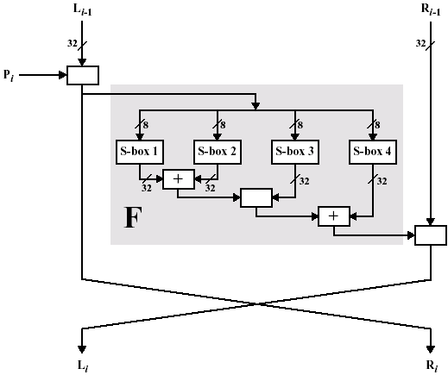
Single Blowfish Round
Uses addition modulo 2³² and XOR
Round function processes four bytes
  F(a, b, c, d) = ((S_{1,a} + S_{2,b}) ⊕ S_{3,c}) + S_{4,d}
  Followed by Feistel swap
⊕
⊕
⊕
Akash Mehta

Slide 92
Blowfish Encryption
Blowfish has 16 rounds.
data is divided into two 32-bit halves L₀ & R₀
  for i = 1 to 16 do
    R_{i} = L_{i-1} XOR P_{i};
    L_{i} = F[R_{i}] XOR R_{i-1};
  L₁₇ = R₁₆ XOR P₁₈;
  R₁₇ = L₁₆ XOR P₁₇;
where
  F[a,b,c,d] = ((S_{1,a} + S_{2,b}) XOR S_{3,c}) + S_{4,a}
Akash Mehta

Slide 93
CAST-128
Developed by Carlisle Adams and Stafford Tavares
Used in IPSec
64-bit block, 40- to 128-bit keys (in 8-bit increments)
Classical Feistel network structure
  Sixteen rounds
  Two subkeys per round, one 32-bit (Km_{i}), one 5-bit (Kr_{i})
  Three different round functions
  Four operations: addition(+) and subtraction(-) modulo 2³² , XOR, and (variable) circular left rotate (<<<)
Akash Mehta

Slide 94
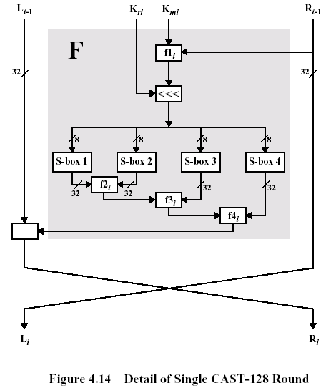
CAST-128 Round Function F
I_{a}
I_{b}
I
I_{c}
I_{d}
⊕
Akash Mehta

Slide 95
Contd…
Encryption
Decryption: same as encryption with the keys applied in reverse order
L₀||R₀ = Plaintext
for i = 1 to 16 do
L_{i} = R_{i-1}
R_{i} = L_{i-1} ⊕ F_{i}[R_{i-1}, Km_{i}, Kr_{i}];
Ciphertext = L₁₆||R₁₆
Akash Mehta

Slide 96
RC2
RC2
Developed by Ron Rivest (RSA Data Security)
64-bit block cipher
Variable key size (from one byte up to 128 bytes)
Designed to be easy to implement on 16-bit microprocessor
  Use 16-bit word, 16-bit arithmetic (addition, XOR, AND, ~, rotate)
Non-Feistel
18 rounds (mixing/mashing)
Used in S/MIME
Akash Mehta

Slide 97
RC2 Key Expansion
RC2
RC2 assumes 128 (64 word) byte key buffer
  For byte operation, key array is L[0], …, L[127]; each L[i] is a byte
  For word operation, key array is K[0], …, K[63]; each K[i] is a 16-bit word
Akash Mehta

Slide 98
RC2 Encryption
RC2
Encryption algorithm takes a 64-bit input stored in R[0], R[1], R[2], R[3], and places the result back in R[0] thru R[3].
Algorithm consists of 18 rounds of two types: mixing and mashing
Mixing round:
R[0] = R[0] + K[j] + (R[3] & R[2]) + ((~R[3] & R[1]);
R[0] = R[0] <<< 1;
j = j + 1;
R[1] = R[1] + K[j] + (R[0] & R[3]) + ((~R[0] & R[2]);
R[1] = R[1] <<< 2;
j = j + 1;
R[2] = R[2] + K[j] + (R[1] & R[0]) + ((~R[1] & R[3]);
R[2] = R[2] <<< 3;
j = j + 1;
R[3] = R[3] + K[j] + (R[2] & R[1]) + ((~R[2] & R[0]);
R[3] = R[3] <<< 5;
j = j + 1;
Here j is the global variable; K[j] is the first
subkey word that has not yet been used
Akash Mehta

Slide 99
RC2 Encryption
RC2
Mashing round
RC2
  Initialize j to zero
  Perform five mixing rounds (j = 20)
  Perform one mashing round
  Perform six mixing rounds (j = 44)
  Perform one mashing round
  Perform five mixing rounds (j=64)
Decryption: Inverse operation of encryption with the keys used in reverse order
R[0] = R[0] + K[R[3] & 63];
R[1] = R[1] + K[R[0] & 63];
R[2] = R[2] + K[R[1] & 63];
R[3] = R[3] + K[R[2] & 63];
Akash Mehta

Slide 100
Characteristics of Advanced Block Ciphers
Key features found in advanced symmetric block ciphers
Variable key length
  Blowfish, RC5, CAST-128, RC2
Mixed operators
  More than one arithmetic and/or Boolean operator, especially ones that are not associative or distributive
  These operators provide nonlinearity as an alternative to S-boxes
Data-dependent rotation
  Provide excellent confusion and diffusion
  RC5
Key-dependent rotation
  CAST-128
Akash Mehta

Slide 101
Characteristics of Advanced Block Ciphers
Key-dependent S-boxes
  Blowfish
Expensive key schedule computation
  Blowfish
Variable round function (F)
  CAST-128
Variable plaintext/ciphertext block length
  RC5
Variable number of rounds
  RC5
Operation on both data halves each round
  IDEA, Blowfish, RC5
Akash Mehta

Slide 102
Random Number Generator (RNG)
A RNG is a device that is very specifically designed to generate a series of numbers or symbols that do not exhibit any specific pattern.
In other words, they appear to be quite random.
Many programming languages provide facilities to generate random numbers.
Random number generated by computers are not truly random-over a period of time, we can predict them.
Akash Mehta

Slide 103
Symmetric-key distribution(Key Distribution)
16.<number>
In a community with n entities, n (n − 1)/2 keys are needed for symmetric-key communication.
The number of keys is not the only problem: the distribution of keys is another.
  If Alice and Bob want to communicate, they need a way to exchange a secret key. If Alice wants to communicate with a million people, how can she exchange a million keys with them? Using the Internet is definitely not a secure method. It is obvious that we need an efficient way to maintain and distribute secret keys.
Akash Mehta

Slide 104
Key distribution center: KDC
16.<number>
A practical solution is the use of a trusted third party, referred to as a key-distribution center (KDC). Each person establishes a shared secret key with the KDC. A secret key is established between the KDC and each member. The process is as follows:
1. Alice sends a request to the KDC stating that she needs a session (temporary) secret key between herself and Bob.
2. The KDC informs Bob about Alice’s request.
3. If Bob agrees, a session key is created between the two.
i
A session symmetric key between two parties
is used only once.
Akash Mehta

Slide 105
Public-key distribution
16.<number>
In asymmetric-key cryptography, people do not need a symmetric shared key. If Alice wants to send a message to Bob, she only needs to know Bob’s public key, which is open to the public and available to everyone. If Bob needs to send a message to Alice, he only needs to know Alice’s public key, which is also known to everyone. In public-key cryptography, everyone shields a private key and advertises a public key.
i
In public-key cryptography, everyone has access to everyone’s public key –
public keys are available to the public.
Akash Mehta

